Slide 1

Patient Relationship System
Maria Kurisoo, Hayley Smith, Alex Socha
CSCI 6622
Group New
May 4, 2021

Slide 2
Overview
System Description
Purpose & Benefits
E.R. Model
SQL Database
GUI
Team Description
References

Slide 3
System Description
Users: Small private primary care medical offices
Information stored (more details in ER Model):
Patient relationships (including basic information)
Providers that patients see
Emergency contact
Legal guardian (if applicable)
Preferred pharmacy
No more than 1000 patients per provider (World Health Organization recommendation for small medical offices)

Slide 4
Purpose & Benefits
Small private primary care medical offices (especially those with few healthcare providers) often do not have the funds for a robust database
Patient Relationship System database is small and simple, which allows it to be more affordable and convenient
Does not include information beyond what is necessary to understand the relationships of the patient
Allows for quick access to pertinent relationship information

Slide 5
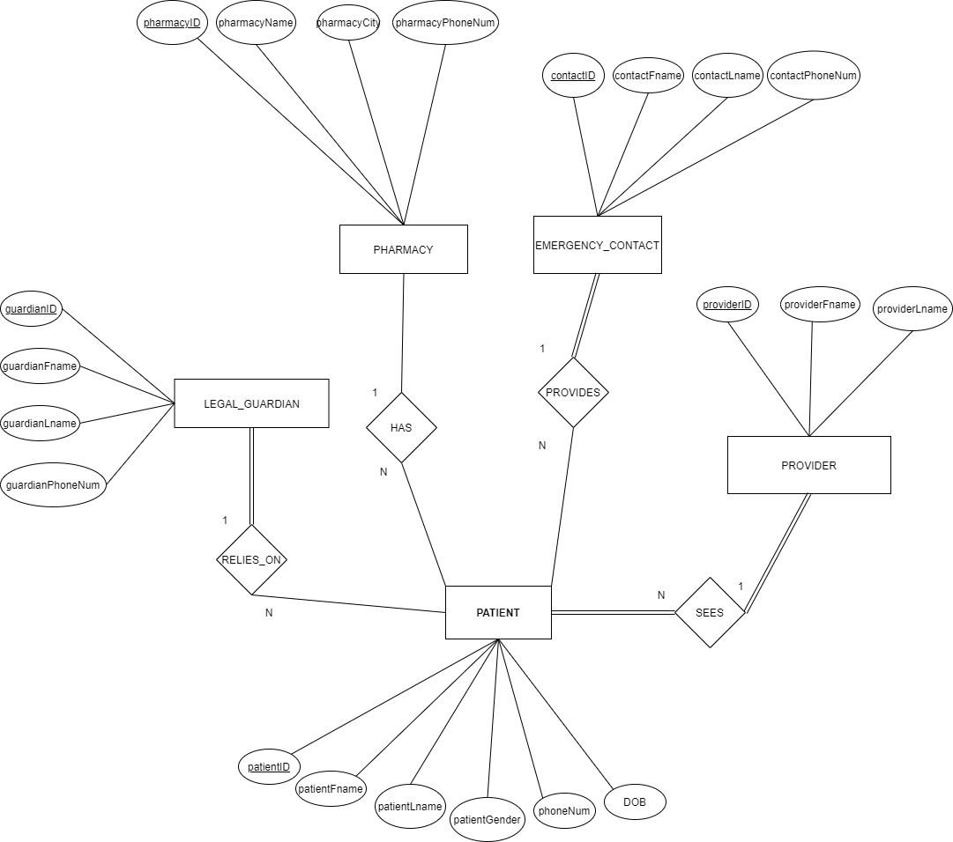
Entity Relationship Model

Slide 6
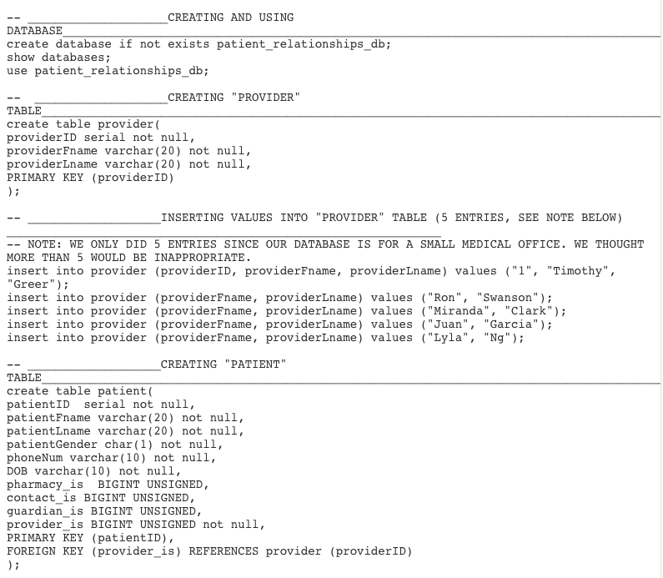
SQL Database
Creating and using database
Creating Providers table and adding them into the database
Creating Patient table

Slide 7
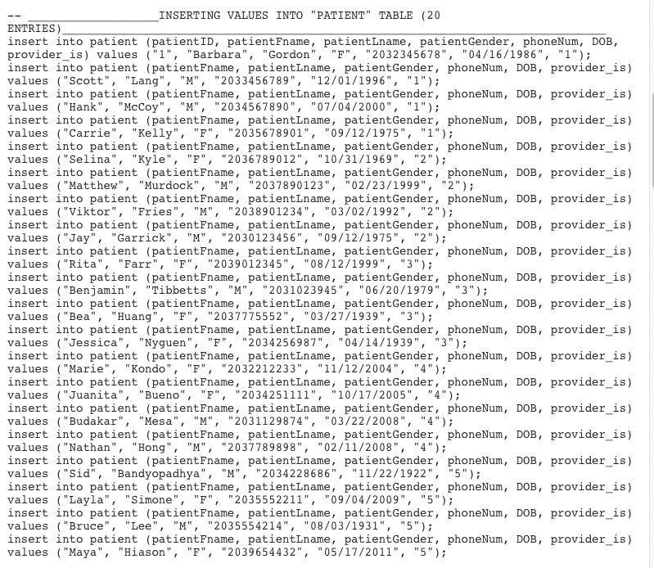
SQL Database
Inserting patients into table

Slide 8
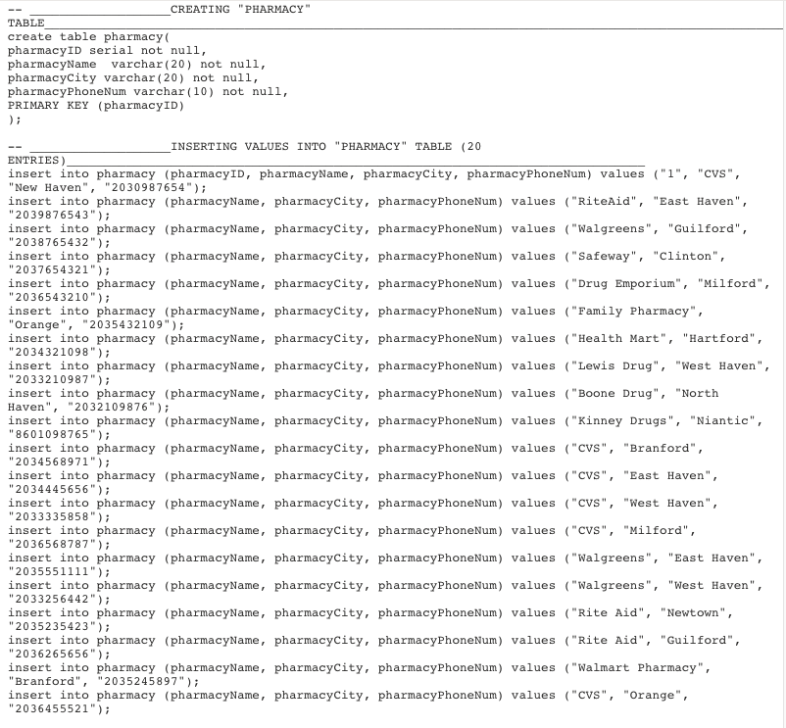
SQL Database
Created Pharmacy table
Inserting pharmacy into table

Slide 9
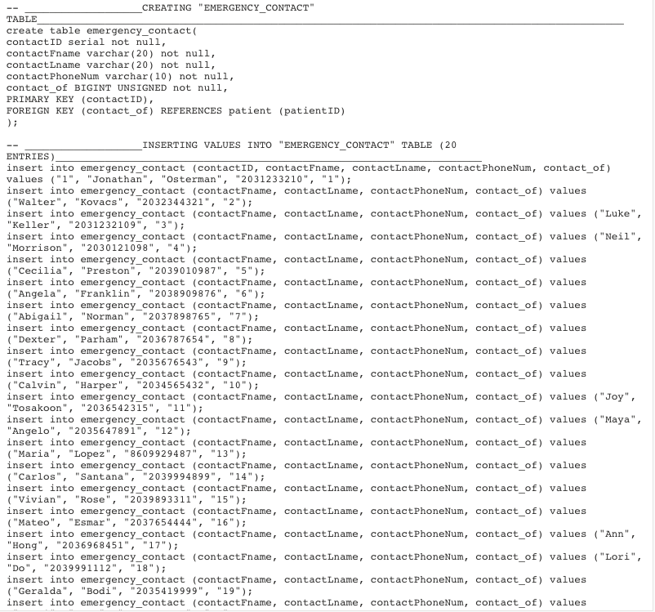
SQL Database
Creating Emergency Contact table
Inserting emergency contacts into table

Slide 10
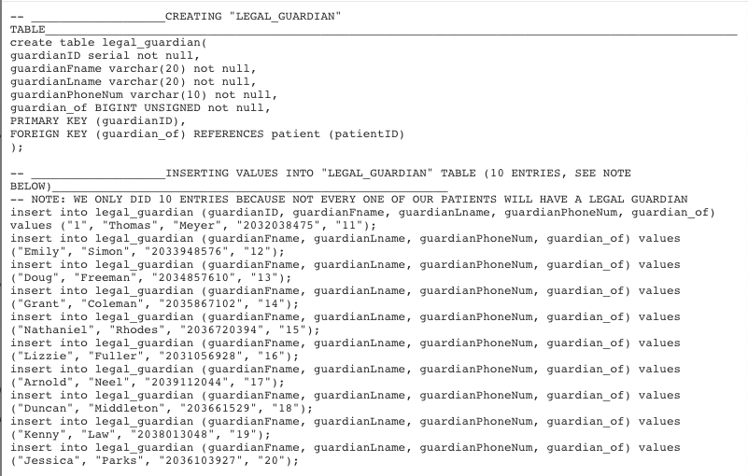
SQL Database
Creating Legal Guardian table
Inserting legal guardians into table

Slide 11
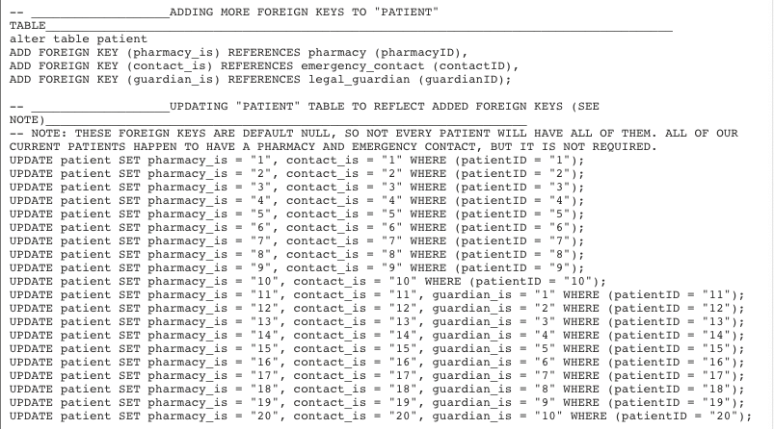
SQL Database
Adding foreign keys to patient table
Updating patient table to reflect foreign keys

Slide 12
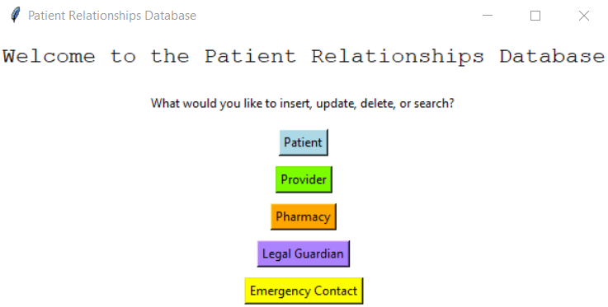
GUI
First window that pops up

Slide 13
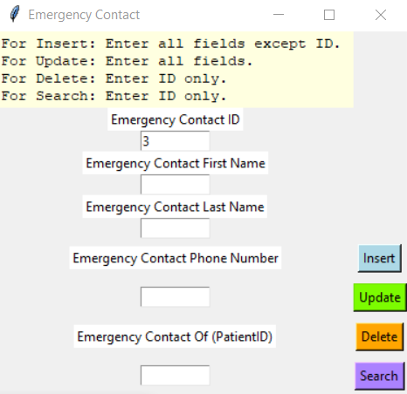
GUI
Emergency contact window (in this example, we searched the emergency contact with the ID of 3)

Slide 14
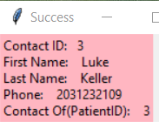
GUI
Emergency contact search success Window

Slide 15
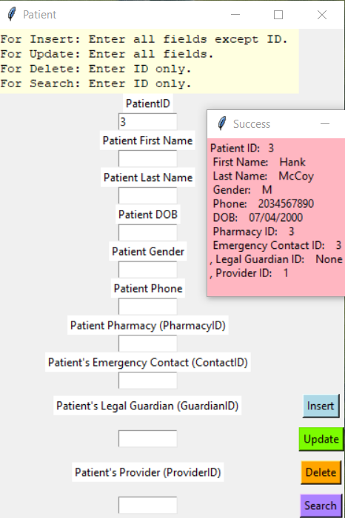
GUI
Patient search using the patients ID and success window

Slide 16
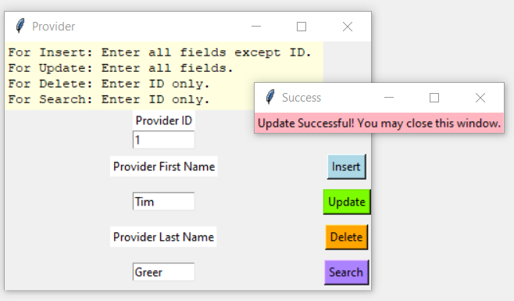
GUI
Update patient window and success window

Slide 17
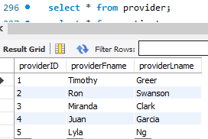
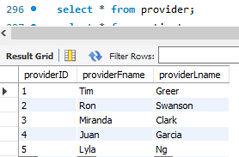
SQL Database Updated From Previous Slide
Before Update
After Update

Slide 18
Team Description
Maria Kurisoo: mkuri1@unh.newhaven.edu
Hayley Smith: hsmit9@unh.newhaven.edu
Alex Socha: asoch1@unh.newhaven.edu

Slide 19
Reference
Kumar, R., & Pal, R. (2018). India achieves who recommended doctor POPULATION ratio: A call for paradigm shift in public Health discourse! Retrieved May 04, 2021, from https://www.ncbi.nlm.nih.gov/pmc/articles/PMC6259525/

